Slide 1
GRADE 7 ACCELERATED · UNIT 3 · LESSON 3
Exponential Expressions
MA.7.NSO.1.1
I can apply more than one law of exponents to evaluate an expression and to write an equivalent one.
Yesterday: seven laws, one at a time.
Today: two or three laws in one expression — and the order is yours.
Grade 7 Accelerated · Unit 3 · Lesson 3 — Exponential Expressions
1

Slide 2
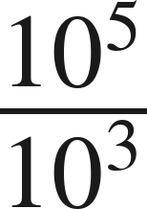



Warm-Up
On your own. Four minutes. No notes.
1. Find the value:
2. Is
closer to 7 or to 8?
3. Solve
4. Evaluate
Grade 7 Accelerated · Unit 3 · Lesson 3 — Exponential Expressions
2

Slide 3
Warm-Up
Answers.
1. Find the value:
100
2. Is
closer to 7 or to 8?
7
3. Solve
x = 5
4. Evaluate
50
Grade 7 Accelerated · Unit 3 · Lesson 3 — Exponential Expressions
3

Slide 4
Notes
Copy the table. It is your reference for the rest of the unit.
I. The seven laws, in one place
Law | Rule | Example
Product of powers | a^{m} · a^{n} = a^{m+n} | 2³ · 2¹ = 2⁴
Quotient of powers | a^{m} ÷ a^{n} = a^{m-n} | (−3)⁷ ÷ (−3)² = (−3)⁵
Power of a product | (ab)^{m} = a^{m} · b^{m} | (−7 · 3)² = (−7)² · 3²
Power of a quotient | (a ÷ b)^{m} = a^{m} ÷ b^{m} | (13 ÷ 5)³ = 13³ ÷ 5³
Power of a power | (a^{m})^{n} = a^{mn} | (6³)⁴ = 6¹²
Identity exponent | a¹ = a | 15¹ = 15
Zero exponent | a⁰ = 1 | 127⁰ = 1
Grade 7 Accelerated · Unit 3 · Lesson 3 — Exponential Expressions
4

Slide 5
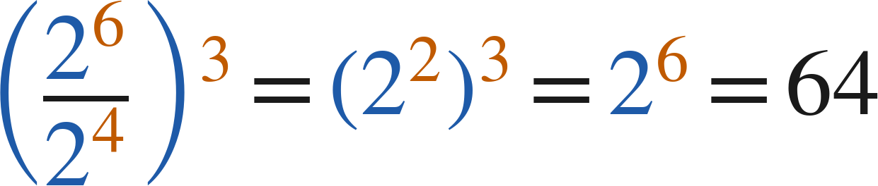
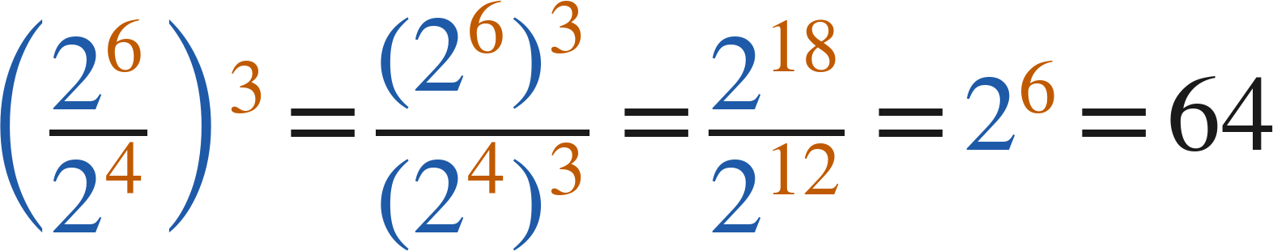
Notes
Two students, two orders, one value.
II. More than one law — make a plan, then follow it
Winston:
Yvette:
Different plans, same value. Any correct sequence of laws gives the same answer.
Grade 7 Accelerated · Unit 3 · Lesson 3 — Exponential Expressions
5

Slide 6
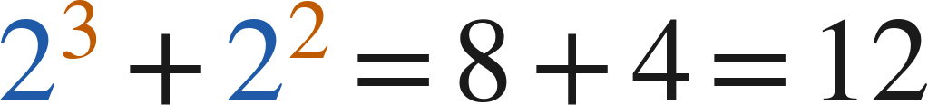

Notes
III. Order of operations still applies
A.
Parentheses first — including a fraction bar, which is a pair of parentheses in disguise.
B.
Exponents next — the laws of exponents are applied here.
C.
Then multiply and divide, left to right; then add and subtract.
D.
Never across a + or a −:
, not
.
Grade 7 Accelerated · Unit 3 · Lesson 3 — Exponential Expressions
6

Slide 7
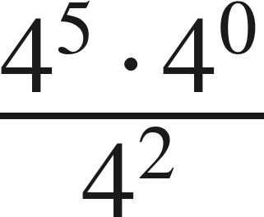
Example 1
A zero exponent inside a product inside a quotient.
Make a plan. Then find the value.
Grade 7 Accelerated · Unit 3 · Lesson 3 — Exponential Expressions
7

Slide 8
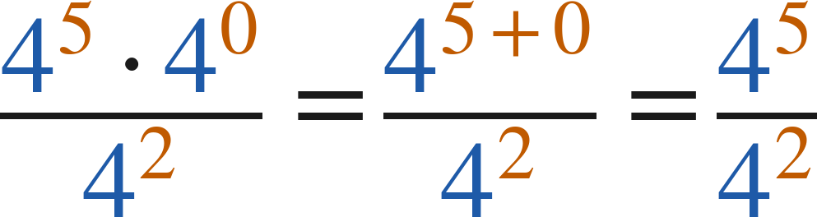
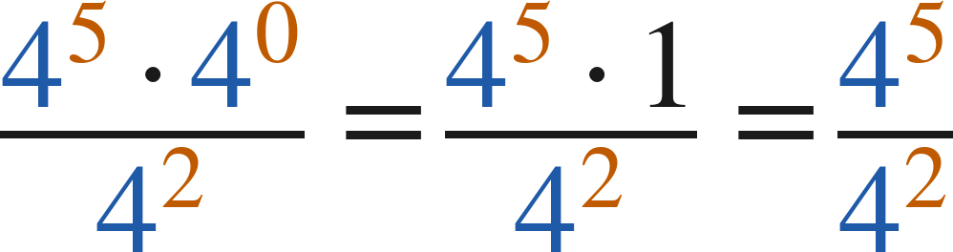
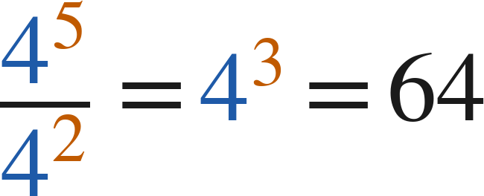
Example 1
Worked — Caroline's plan and Jamir's plan.
Caroline: product of powers first
Jamir: zero exponent first
both: quotient of powers, then evaluate
Answer: 64
Grade 7 Accelerated · Unit 3 · Lesson 3 — Exponential Expressions
8

Slide 9
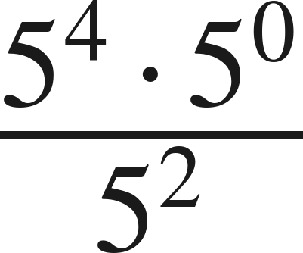
Your Turn
Same steps, your numbers. Boards up when done.
Grade 7 Accelerated · Unit 3 · Lesson 3 — Exponential Expressions
9

Slide 10
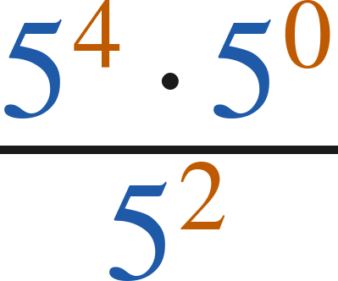
Your Turn
Answer.
5⁴ · 1 over 5², so 5²
Answer: 5² = 25
Grade 7 Accelerated · Unit 3 · Lesson 3 — Exponential Expressions
10

Slide 11
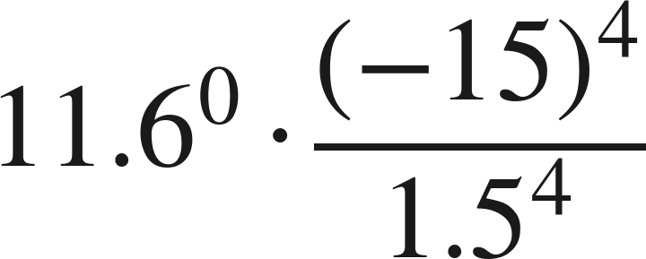
Example 2
Three laws, a decimal and a negative base.
Make a plan. Then find the value.
Grade 7 Accelerated · Unit 3 · Lesson 3 — Exponential Expressions
11

Slide 12
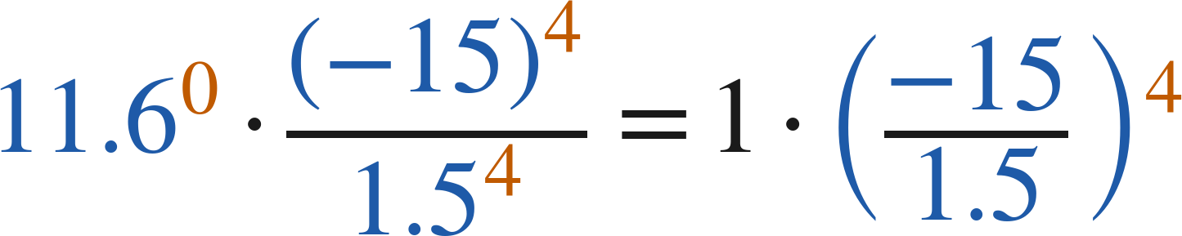
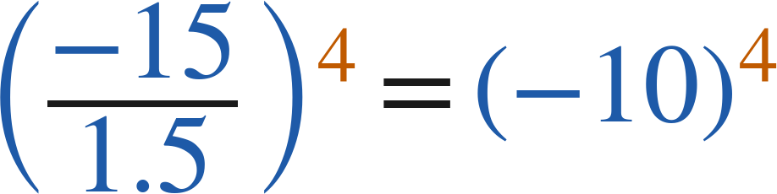

Example 2
Worked.
zero exponent; power of a quotient, backwards
divide inside: −15 ÷ 1.5 = −10
four negative factors: positive
Answer: 10,000
Grade 7 Accelerated · Unit 3 · Lesson 3 — Exponential Expressions
12

Slide 13
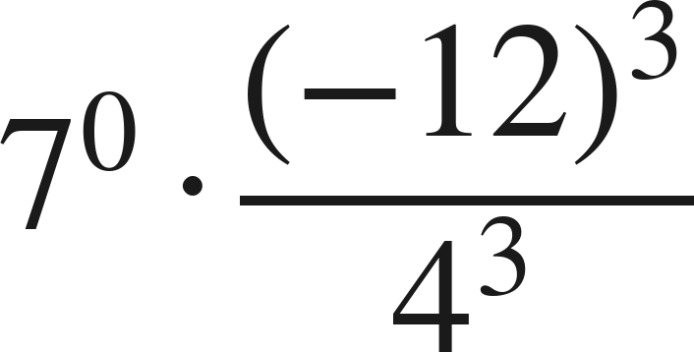
Your Turn
Same steps, your numbers. Boards up when done.
Grade 7 Accelerated · Unit 3 · Lesson 3 — Exponential Expressions
13

Slide 14
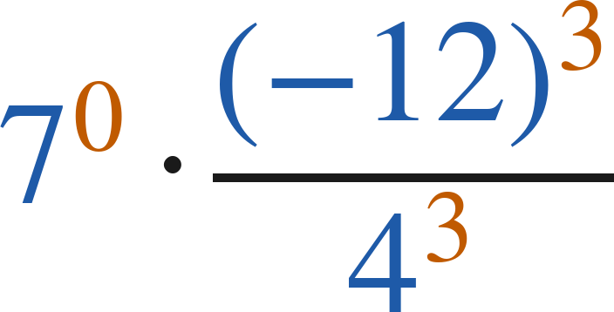
Your Turn
Answer.
1 · (−12 ÷ 4)³ = (−3)³
Answer: −27
Grade 7 Accelerated · Unit 3 · Lesson 3 — Exponential Expressions
14

Slide 15


Whiteboards · Question 1 of 9
Boards up on three.
A spreadsheet holds
cells in
equal columns.
The file is 3 megabytes.
How many cells are in each column?
Answer it.
Find the value.
Grade 7 Accelerated · Unit 3 · Lesson 3 — Exponential Expressions
15

Slide 16


Whiteboards · Question 1 of 9
Answer.
A spreadsheet holds
cells in
equal columns.
The file is 3 megabytes.
How many cells are in each column?
6⁴ · 1 over 6², so 6²
Answer: 36
Grade 7 Accelerated · Unit 3 · Lesson 3 — Exponential Expressions
16

Slide 17
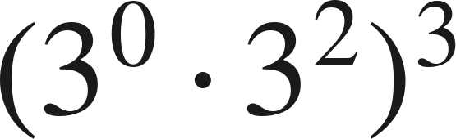
Whiteboards · Question 2 of 9
Boards up on three.
Answer it.
Find the value.
Grade 7 Accelerated · Unit 3 · Lesson 3 — Exponential Expressions
17

Slide 18
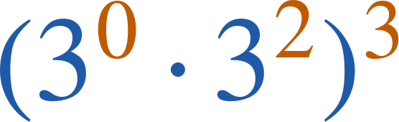
Whiteboards · Question 2 of 9
Answer.
(3²)³ = 3⁶
Answer: 729
Grade 7 Accelerated · Unit 3 · Lesson 3 — Exponential Expressions
18

Slide 19
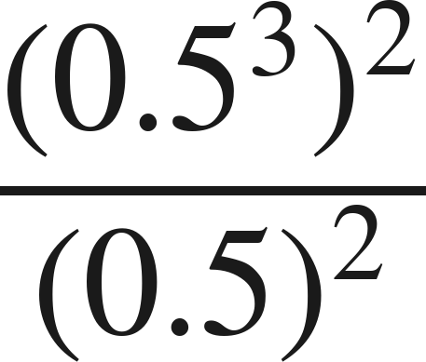
Whiteboards · Question 3 of 9
Boards up on three.
Answer it.
Find the value.
Grade 7 Accelerated · Unit 3 · Lesson 3 — Exponential Expressions
19

Slide 20
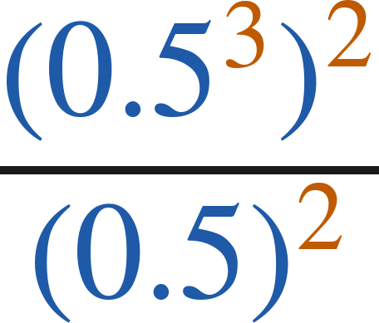
Whiteboards · Question 3 of 9
Answer.
0.5⁶ ÷ 0.5² = 0.5⁴
Answer: 0.0625
Grade 7 Accelerated · Unit 3 · Lesson 3 — Exponential Expressions
20

Slide 21
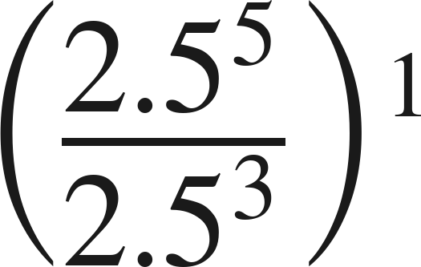
Whiteboards · Question 4 of 9
Boards up on three.
Answer it.
Find the value.
Grade 7 Accelerated · Unit 3 · Lesson 3 — Exponential Expressions
21

Slide 22
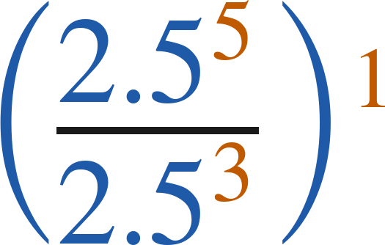
Whiteboards · Question 4 of 9
Answer.
2.5² — the exponent 1 changes nothing
Answer: 6.25
Grade 7 Accelerated · Unit 3 · Lesson 3 — Exponential Expressions
22

Slide 23
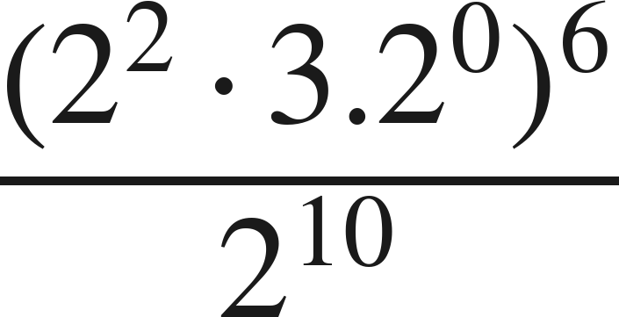
Whiteboards · Question 5 of 9
Boards up on three.
Which is the value?
A. 4
B. 2²²
C. 0
D. 1/4
Answer it.
Grade 7 Accelerated · Unit 3 · Lesson 3 — Exponential Expressions
23

Slide 24
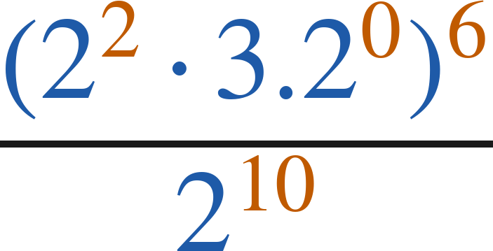
Whiteboards · Question 5 of 9
Answer.
Which is the value?
A. 4
B. 2²²
C. 0
D. 1/4
Answer: A — 4
Grade 7 Accelerated · Unit 3 · Lesson 3 — Exponential Expressions
24

Slide 25
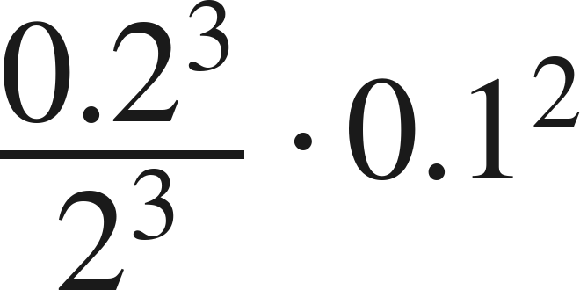
Whiteboards · Question 6 of 9
Boards up on three.
Which expression is equivalent?
A. 0.1⁵
B. 0.2⁰ · 0.1²
C. 0.1⁶
D. 0.2³ · 0.1²
Answer it.
Grade 7 Accelerated · Unit 3 · Lesson 3 — Exponential Expressions
25

Slide 26
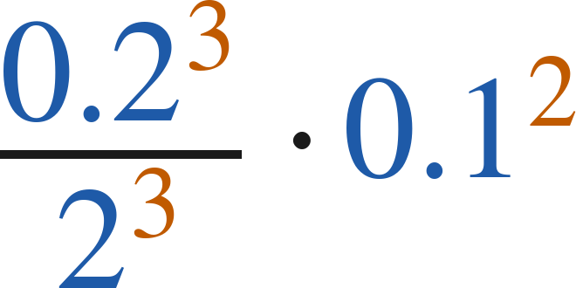
Whiteboards · Question 6 of 9
Answer.
Which expression is equivalent?
A. 0.1⁵
B. 0.2⁰ · 0.1²
C. 0.1⁶
D. 0.2³ · 0.1²
Answer: A — 0.1⁵
Grade 7 Accelerated · Unit 3 · Lesson 3 — Exponential Expressions
26

Slide 27
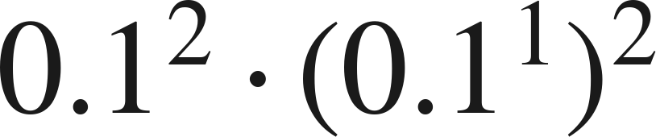
Whiteboards · Question 7 of 9
Boards up on three.
Answer it.
Find the value.
Grade 7 Accelerated · Unit 3 · Lesson 3 — Exponential Expressions
27

Slide 28

Whiteboards · Question 7 of 9
Answer.
0.1² · 0.1² = 0.1⁴
Answer: 0.0001
Grade 7 Accelerated · Unit 3 · Lesson 3 — Exponential Expressions
28

Slide 29
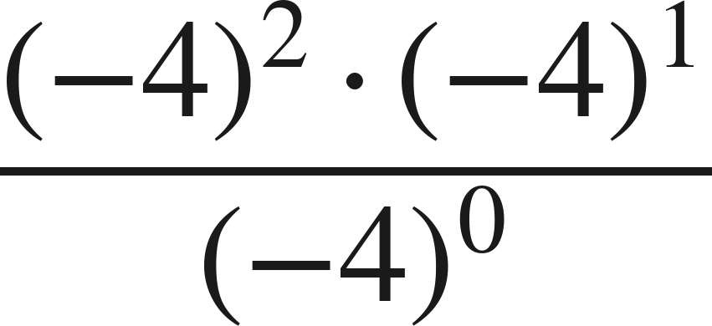
Whiteboards · Question 8 of 9
Boards up on three.
Answer it.
Find the value.
Grade 7 Accelerated · Unit 3 · Lesson 3 — Exponential Expressions
29

Slide 30
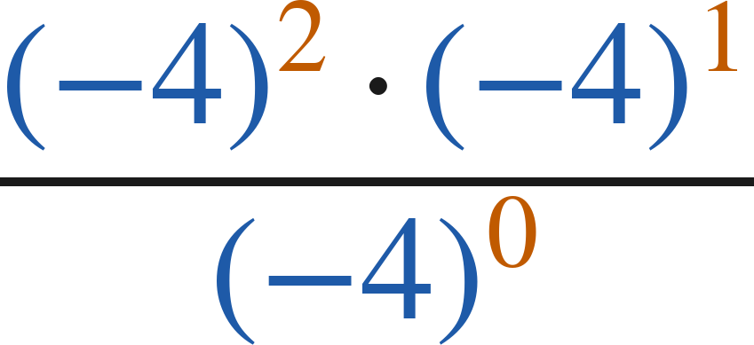
Whiteboards · Question 8 of 9
Answer.
(−4)³ over 1
Answer: −64
Grade 7 Accelerated · Unit 3 · Lesson 3 — Exponential Expressions
30

Slide 31
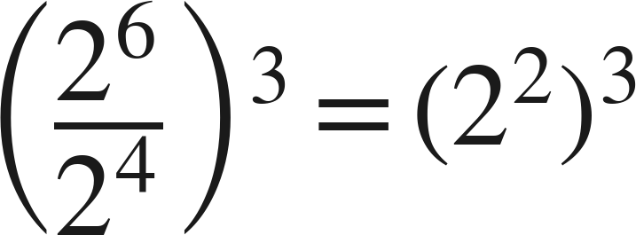
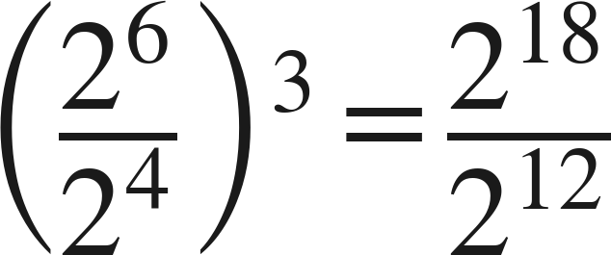
Whiteboards · Question 9 of 9
Take your time. Boards up when you have written it.
Winston writes
. Yvette writes
.
Do they get the same value? Explain.
Write your answer in sentences.
Name the law each one used first, and give the value.
Grade 7 Accelerated · Unit 3 · Lesson 3 — Exponential Expressions
31

Slide 32
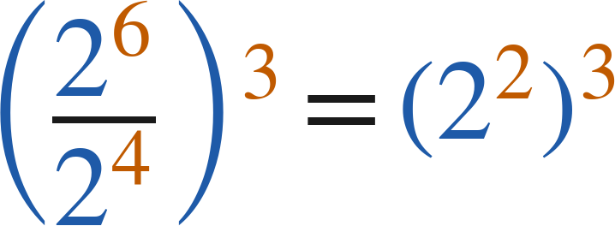
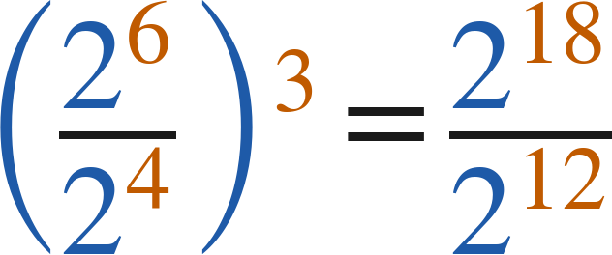
Whiteboards · Question 9 of 9
Answer.
Winston writes
. Yvette writes
.
Do they get the same value? Explain.
both plans end at 2⁶
Answer: Yes — both give 2⁶ = 64
Grade 7 Accelerated · Unit 3 · Lesson 3 — Exponential Expressions
32

Slide 33
Independent Set
Six questions. On your own, in silence.
1.
Six questions. Work down the page.
2.
Show the step that does the work, not just the answer.
3.
Silence until the six minutes are up.
Grade 7 Accelerated · Unit 3 · Lesson 3 — Exponential Expressions
33

Slide 34
IXL
Last five minutes.
1.
Open IXL and start today's skills.
2.
Work on paper where the question needs work. The answer box does not show it.
3.
Every skill listed is required, to a SmartScore of 67. Due at the start of the next class.
Today's skills — all required
Evaluate expressions using properties of exponents — ZE9
Grade 7 Accelerated · Unit 3 · Lesson 3 — Exponential Expressions
34

